Slide 1


05- Summarizing Basic Cryptographic Concepts
Ehab Fahmi
Senior Cyber Security Consultant - Instructor

Slide 2
CRYPTOGRAPHIC CONCEPTS
Cryptography
(literally meaning "secret writing") has been around for thousands of years.
It is the art of making information secure by encoding it.
Security through obsecurity means keeping something a secret by hiding it.
This is generally acknowledged to be impossible (or at least, high risk) on any sort of computer network.
With cryptography, it does not matter if third parties know of the existence of the secret,
because they can never know what it is without obtaining an appropriate credential.

Slide 3
CRYPTOGRAPHIC CONCEPTS (cont.)
The following terminology is used to discuss cryptography:
Plaintext (or cleartext)—an unencrypted message.
Ciphertext—an encrypted message.
Cipher—the process (or algorithm) used to encrypt and decrypt a message.
Cryptanalysis—the art of cracking cryptographic systems.
In discussing cryptography and attacks against encryption systems, it is customary to use a cast of characters to describe different actors involved in the process of an attack, The main characters are:
Alice—the sender of a genuine message.
Bob—the intended recipient of the message.
Mallory—a malicious attacker attempting to subvert the message in some way.

Slide 4
HASHING ALGORITHMS
Hashing is the simplest type of cryptographic operation.
A cryptographic hashing algorithm produces a fixed length string from an input
plaintext that can be of any length.
The output can be referred to as a checksum, message digest, or hash.
The function is designed so that it is impossible to recover the plaintext data from the digest (one-way) and so that different inputs are unlikely to produce the same output (a collision).

Slide 5
HASHING ALGORITHMS (cont.)
A hashing algorithm is used to prove integrity.
For Example: Bob and Alice can compare the values used for a password in the following way:
Bob already has a digest calculated from Alice's plaintext password.
Bob cannot recover the plaintext password value from the hash.
When Alice needs to authenticate to Bob, she types her password, converts it to a hash, and
sends the digest to Bob.
Bob compares Alice's digest to the hash value he has on file.
If they match, he can be sure that Alice typed the same password.

Slide 6
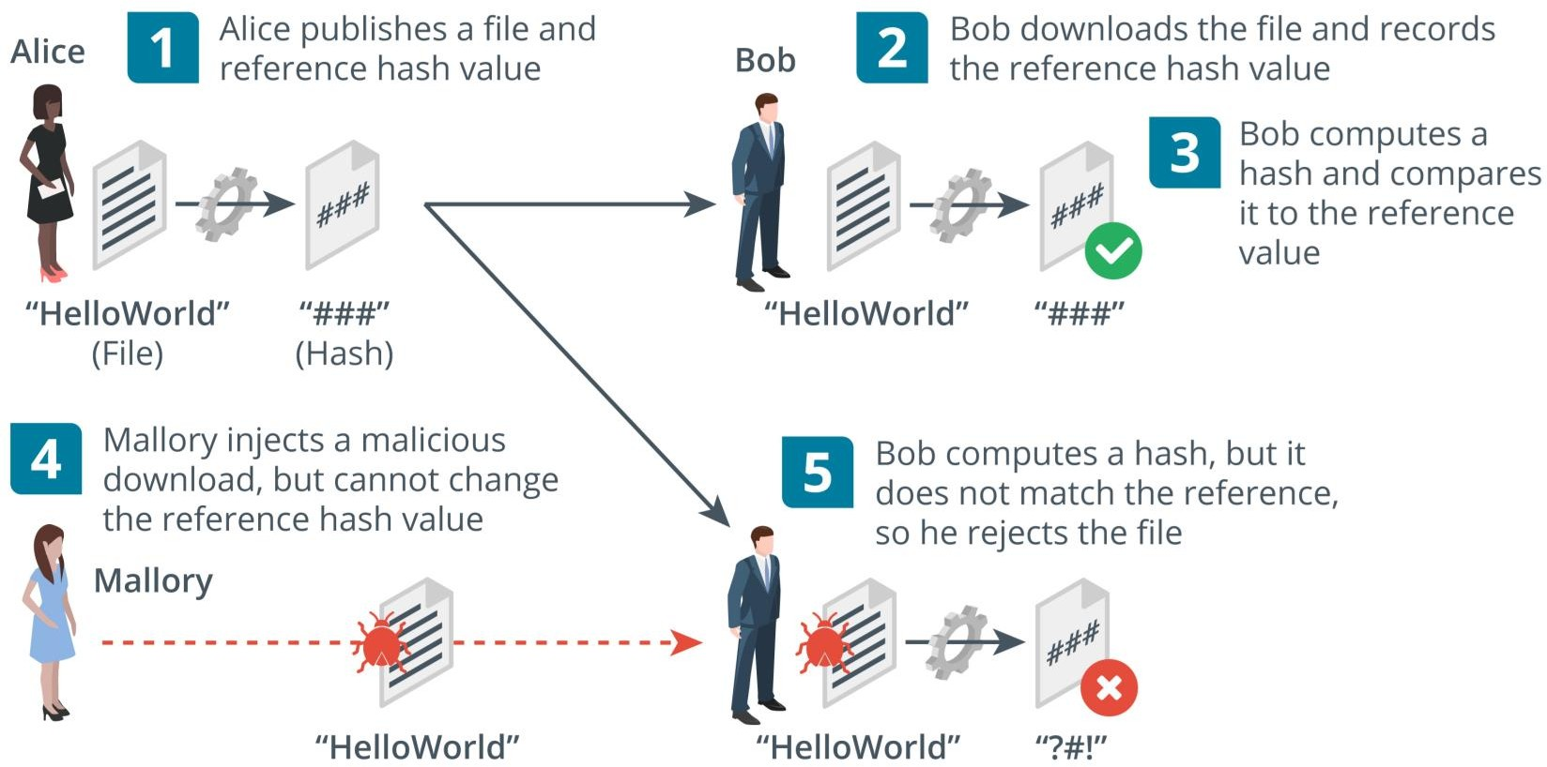
HASHING ALGORITHMS (cont.)

Slide 7
HASHING ALGORITHMS (cont.)
As well as comparing password values, a hash of a file can be used to verify the integrity of that file after transfer.
Alice runs a hash function on the setup.exe file for her product.
She publishes the digest to her website with a download link for the file.
Bob downloads the setup.exe file and makes a copy of the digest.
Bob runs the same hash function on the downloaded setup.exe file and compares it to the reference value published by Alice.
If it matches the value published on the website, the integrity of the file can be assumed.
Consider that Mallory might be able to substitute the download file for a malicious file.
Mallory cannot change the reference hash, however.
This time, Bob computes a hash but it does not match, leading him to suspect that the file has been tampered with.

Slide 8
HASHING ALGORITHMS (cont.)
There are two popular implementations hash algorithms:
Secure Hash Algorithm (SHA)
Considered the strongest algorithm.
There are variants that produce different-sized outputs, with longer digests considered more secure.
The most popular variant is SHA-256, which produces a 256-bit digest.
Message Digest Algorithm #5 (MD5)
Produces a 128-bit digest.
MD5 is not considered to be quite as safe for use as SHA-256, but it might be required for compatibility between security products.

Slide 9
ENCRYPTION CIPHERS AND KEYS
While a hash function can be used to prove the integrity of data, it cannot be used to store or transmit data.
The plaintext cannot be recovered from the digest.
An encryption algorithm is a type of cryptographic process that encodes data so that it can be recovered, or decrypted.
The use of a key with the encryption cipher ensures that decryption can only be performed by authorized persons.

Slide 10
SYMMETRIC ENCRYPTION
A symmetric cipher is one in which encryption and decryption are both performed by the same secret key.
The secret key is so-called because it must be kept secret.
If the key is lost or stolen, the security is breached.
Symmetric encryption is used for confidentiality.
For example, Alice and Bob can share a confidential file in the following way:
Alice and Bob meet to agree which cipher to use and a secret key value.
They both record the value of the secret key, making sure that no one else can discover it.
Alice encrypts a file using the cipher and key.
She sends only the ciphertext to Bob over the network.
Bob receives the ciphertext and is able to decrypt it by applying the same cipher with his
copy of the secret key.

Slide 11
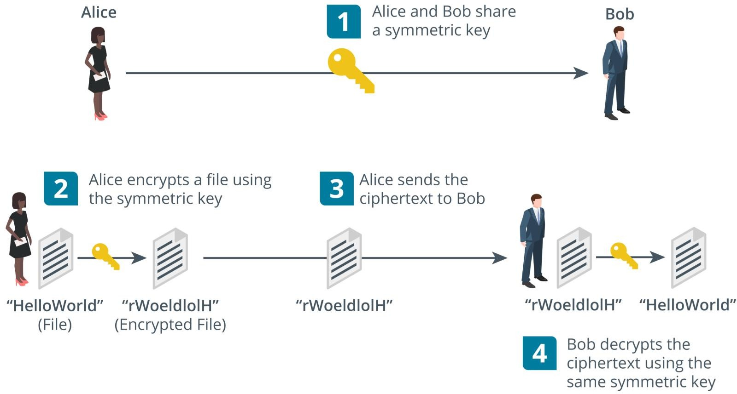
SYMMETRIC ENCRYPTION (cont.)

Slide 12
SYMMETRIC ENCRYPTION (cont.)
Symmetric encryption is also referred to as single key or private key or shared secret.
Symmetric encryption is very fast.
It is used for bulk encryption of large amounts of data.
The main problem is secure distribution and storage of the key, or the exact means by which Alice and Bob "meet" to agree on the key.
If Mallory intercepts the key and obtains the ciphertext, the security is broken.
Note that symmetric encryption cannot be used for authentication or integrity, because Alice and Bob are able to create exactly the same secrets, because they both know the same key.

Slide 13
ASYMMETRIC ENCRYPTION
In a symmetric encryption cipher, the same secret key is used to perform both encryption and decryption operations.
With an asymmetric cipher, operations are performed by two different but
related public and private keys in a key pair.
Each key is capable of reversing the operation of its pair.
For Example: if the public key is used to encrypt a message, only the paired private key can decrypt the ciphertext produced.
The public key cannot be used to decrypt the ciphertext, even though it was used to encrypt it.

Slide 14
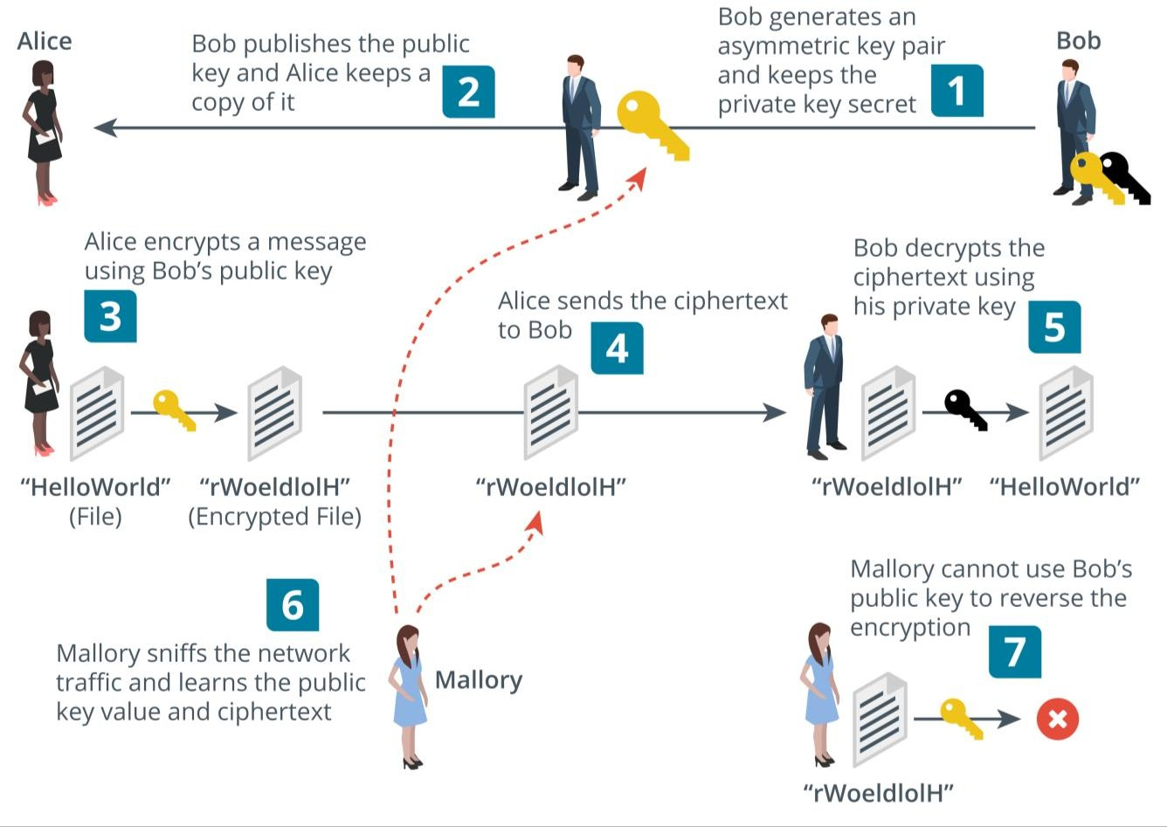
ASYMMETRIC ENCRYPTION (cont.)

Slide 15
ASYMMETRIC ENCRYPTION (cont.)
Bob generates a key pair and keeps the private key secret.
Bob publishes the public key.
Alice wants to send Bob a confidential message, so she takes a copy of Bob's
public key.
Alice uses Bob's public key to encrypt the message.
Alice sends the ciphertext to Bob.
Bob receives the message and is able to decrypt it using his private key.
If Mallory has been snooping, he can intercept both the message and the public key.
However, Mallory cannot use the public key to decrypt the message, so the system remains secure.

Slide 16
PUBLIC KEY CRYPTOGRAPHY ALGORITHMS
Asymmetric encryption is often referred to as public key cryptography.
Many public key cryptography products are based on the RSA algorithm.
The RSA algorithm provides the mathematical properties for deriving key pairs and performing the encryption and decryption operations.
This type of algorithm is called a trapdoor function, because it is easy to perform using the public key, but difficult to reverse without knowing the private key.
Elliptic curve cryptography (ECC) is another type of trapdoor function that can be used in public key cryptography ciphers.
ECC used with a key size of 256 bits is very approximately comparable to RSA with a key size of 2048 bits.

